Slide 1
WK 1.08
Cells: Prokaryotes

Slide 2
REMINDER: Cell Theory
All living organisms are composed of cells. They may be unicellular or multicellular.
The cell is the basic unit of life.
Cells arise from pre-existing cells.

Slide 3
2 Main Kinds
When we look at types of cells, we break them down into two main categories:
Prokaryotes
“simple”
“circular DNA”
Cell wall
Eukaryotes
Complex
Have “organelles”

Slide 4
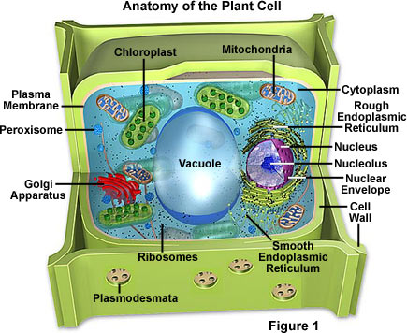
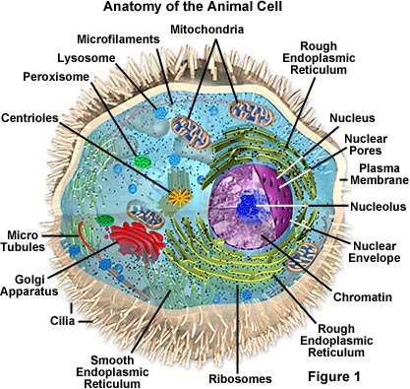
Eukarotes (Plant, Fungi, Animal)
http://micro.magnet.fsu.edu/cells/

Slide 5
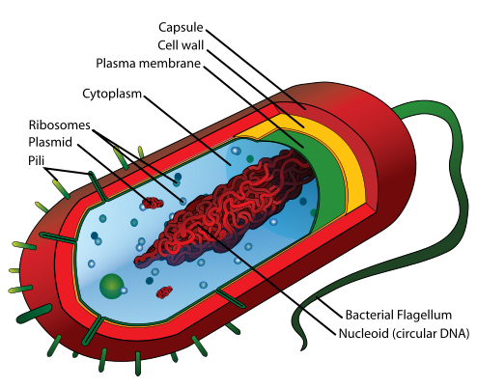
Prokaryotes
Is it THAT simple?.
Photo: wiki

Slide 6
Prokaryotes
YES!

Slide 7
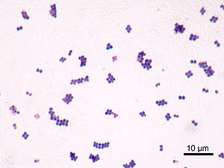
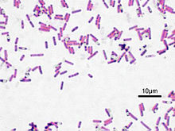
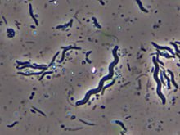
Bacterial shapes
Staphylococcus bacteria
Bacillus
Spirillum
Photo: wiki

Slide 8
REMEMBER
Prokaryotes DO NOT have a nucleus, mitochondria, or any other membrane-bound organelles. They DO have a cell wall.
Photo: wiki

