Slide 1
The Resting Potential and the Action Potential

Slide 2
When a neuron sends a signal down it’s axon to communicate with another neuron, this is called an action potential. When the action potential reaches the end of the axon, it is at the presynaptic terminal of the axon. There is a gap (synaptic gap) between the axon and the dendrite of the neighboring neuron, and the message sent by the action potential must cross this gap in order for the message to be carried on to the next neuron (or in some cases, to a muscle cell). The part of the dendrite that the message must reach on the other neuron across the gap is called the postsynaptic terminal.

Slide 3
The electrical impulse carried by the action potential must trigger the release of neurotransmitter into the synaptic gap. Neurotransmitters are the chemical messengers that carry the message from one neuron to the next. They are contained in vesicles (tiny nearly spherical packets) until they are released into the synaptic gap.

Slide 4
The neurotransmitters cross the synaptic gap and bind with the postsynaptic terminal on the neighboring neuron. When this binding takes place, the neurotransmitter can make the neighboring neuron either more likely or less likely to fire an action potential down it’s own axon. If an action potential occurs on the postsynaptic side, then the message is sent on to the next neuron in the chain.

Slide 5
Before an action potential occurs, the neuron is in what is known as the resting potential. “At rest,” there is an electrical charge difference between the inside and the outside of the neuron because of either positively or negatively charged ions. An ion is an atom that has either gained or lost one or more of its electrons. The ions that are most often discussed when talking about action potentials are sodium (Na+), potassium (K+) and Chloride (Cl-). The inside of the neuron is more negatively charged than the outside of the neuron, and the neuron is said to be polarized (meaning that there is a difference in electrical charge between the inside and outside of the neuron). This prepares the neuron for an action potential, and so the neuron is said to be in dynamic equilibrium during the resting potential and ready for a change in it’s electrical charge.

Slide 6
During the resting potential, the membrane (or covering) of the neuron keeps some chemicals from passing back and forth from the inside to the outside of the neuron or from the outside to the inside of the neuron. The membrane is said to be selectively permeable to chemicals. That is, some chemicals pass through the membrane more freely than others. There are channels in the membrane that can permit chemicals to pass into and out of the neuron. During the resting potential, sodium channels are completely closed, but potassium channels are partly open, so potassium can flow slowly out of the neuron.

Slide 7
Sodium is more than ten times more concentrated outside the neuron’s membrane than inside of the neuron. Sodium is removed from inside the neuron and potassium is moved from outside the neuron because of the sodium-potassium pump. The sodium-potassium pump is made of proteins and transports sodium out of the cell and potassium back into the cell. The selective permeability of the cell membrane and the closed sodium gates keeps the sodium that is pumped out of the cell from coming back in.

Slide 8
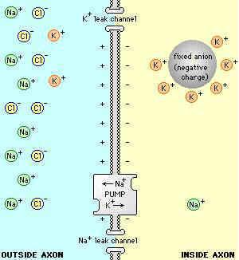
Sodium concentrated on the outside of the cell has a positive charge and chloride has a negative charge. Potassium (with a positive charge) is more heavily concentrated inside the cell. These differences in the charge of sodium, potassium, and chloride keeps the neuron in dynamic equilibrium and ready for an action potential while the neuron is at rest.
Neuron at rest. Sodium (Na+) and Chloride (Cl-) are more concentrated outside the neuron and potassium (K+) are more concentrated inside the neuron during the resting potential.

Slide 9
An action potential happens when some event happens that stimulates the neuron. This could be someone poking you in the ribs with a pencil, the teacher calling your name, or the smell of a hamburger from a fast food restaurant, for example.
If the stimulation gets our attention, then the neuron has gone from a polarized to a depolarized state. Depolarization occurs when polarization is reduced toward zero. In the resting state, the charge inside the cell was about -70 mV. If the stimulation is strong enough (is beyond what is known as the threshold of excitation), then there is a sudden, massive depolarization of the membrane and an action potential occurs. This occurs because the membrane suddenly opens the sodium channels and allows a rapid and massive flow of sodium across the membrane and into the neuron.

Slide 10
The proteins in the membrane that control the entry of sodium into the cell are called voltage-activated channels, and these channels depend on how permeable the membrane is and the voltage difference across the membrane, and this depends on whether the sodium gates are opened or closed. During the resting potential, the sodium gates are closed, but during the action potential the sodium gates open wide and sodium flows freely into the cell. At the peak of the action potential, the inside of the neuron is positively charged rather than negatively charged as a result of the flow of sodium into the cell.

Slide 11
After the peak of the action potential, the potassium channels open and potassium ions flows out of the axon, carrying their positive charge along with them. Enough potassium leaves the neuron to make it even more negative on the inside of the cell than it was during the resting potential. This is known as hyperpolarization. The sodium-potassium pump also begins to pump sodium from inside the cell to the outside of the cell again. The neuron then slowly returns to the resting potential again.

Slide 12
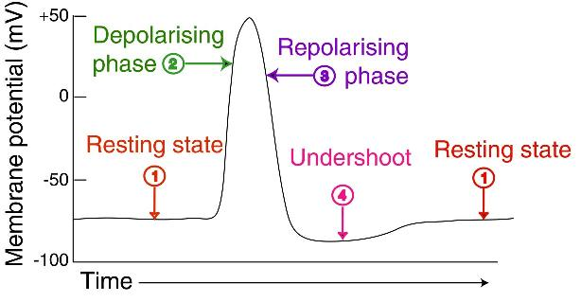
Resting state to action potential. The neuron goes from a polarized state at the resting potential (1) with the neuron more negatively charged inside than outside the membrane to a depolarized state during the action potential (2) with the cell positively charged on the inside. After the action potential, the neuron begins to return to a state of polarization (a return to the resting state) (3). It first overshoots and becomes hyperpolarized (even more negatively charged on the inside of the neuron than in the resting state) (4) and then returns to the resting state (1).

Slide 13
When an action potential occurs, it follows what is known as the all-or-none law. That is, the speed and size/range of the action potential is the same, no matter how weak or strong the stimulus was that caused the action potential. Whether someone pokes you with the eraser end of a pencil or smacks you with a boat oar, the action potential would be the same. That is, if the stimulus was strong enough to cross the threshold of excitement in the first place, the action potential would occur the same way every time. Other factors, such as the timing of action potentials, are what allows us to determine the strength of a stimulus.

Slide 14
Immediately after an action potential, the neuron enters a refractory period, during which it is resistant to producing any additional action potentials. During the first part of the refractory period, the membrane cannot produce an action potential, regardless of how strong a stimulus is. This is known as the absolute refractory period. After a period of time, a stronger than usual stimulus could initiate an action potential. This is known as the relative refractory period. After a brief period of time (possibly four milliseconds), the neuron returns to normal and can again produce an action potential.

